Slide 1
Outline of Tutorial
CFL-reachability
Origin & background
Algorithm & complexity
Applications
Beyond CFL-reachability
Datalog
WPDS, NWA
Graph reachability
Dyck-reach
LCL-reach
InterDyck-reach
Future Directions
Theoretical developments
Dynamic reachability

Slide 2
Part 1
Client Applications
Graph Reachability
Formulation
Graph
Algorithm
Part 2

Slide 3
Client Applications
Graph Reachability
Formulation
Graph
Algorithm
M → M M
| ( M )
| ( )
$$($$
$$)$$
Reachability Framework
a
b
C

Slide 4
Client Applications
Graph Reachability
Formulation
Graph
Algorithm
2. LCL-Reach
3. InterDyck-Reach
1. Dyck-Reach

Slide 5
An alternative view
WPDS, NWA
LCL-reach
CFL-reach
InterDyck-reach
Dyck-reach
Notes:
In terms of a typical system for program analysis, which has the pipeline shown on this slide, the algorithm plays the role of the equation solver. It takes as input the equation system that abstracts the actions of the program, and produces as output the solution to the equation system. That solution is then used to identify possible program flaws, or to establish the correctness of the program’s behavior.
<CLICK>
In essence, what we did was to combine two known techniques to create an improved equation solver.

Slide 6
1. Bidirected Dyck-Reachability
WPDS, NWA
LCL-reach
Formulation
Graph
Algorithm
CFL-reach
InterDyck-reach
M → M M
| ( M )
| ( )
$$($$
$$)$$
Reachability Framework
a
b
C
Dyck-reach

Slide 7
1. Bidirected Dyck-Reachability
WPDS, NWA
LCL-reach
Formulation
Graph
Algorithm
CFL-reach
InterDyck-reach
M → M M
| ( M )
| ( )
$$($$
$$)$$
Reachability Framework
a
b
C
Dyck-reach

Slide 8
Roads so far…
CFL-reachability
Cubic time algorithm [Reps 2000]
Cubic time lower bound [Chatterjee et al. 2019]
Revisiting..
WPDS, NWA
LCL-reach
CFL-reach
InterDyck-reach
Dyck-reach

Slide 9
Bidirected Dyck-reachability
Bidirected Dyck-reachability
Grammar
Graph
S → S S
| (_{i} S )_{i}
| $ε$
$$(_{i}$$
$$)_{i}$$
a
b
a
b

Slide 10
Bidirected Dyck-reachability
Bidirected Dyck-reachability
$$(_{1}$$
$$)_{1}$$
a
b
a
b
$$(_{1}$$
$$)_{1}$$
a
b
a
b
$$)_{1}$$
$$(_{1}$$

Slide 11
Why bidirectedness?
Application-level over-approximation
Field-sensitive Alias analysis [Yan et al. 2011]
Imprecision (due to bidirectedness) [Xu et al. 2009]
$$)_{f}$$
x=y.f
y
x
$$)_{f}$$
$$)_{f}$$
x=z.f y=z.f
x
z
y
$$(_{f}$$
$$(_{f}$$
$$(_{f}$$
x.f=y
y
x
$$(_{f}$$
$$)_{f}$$
x=z.f ; y=z.f
x
z
y
$$(_{f}$$
$$)_{f}$$
x=z.f ; z.f=y
y
z
x
$$(_{f}$$
$$)_{f}$$
z.f=x ; y=z.f
x
z
y
$$(_{f}$$
$$)_{f}$$
Imprecision!
z.f=x ; z.f=y
x
z
y

Slide 12
Why bidirectedness?
Algorithm-level over-approximation
Digraph G
Bidirected graph G’
$$(_{1}$$
$$)_{1}$$
Imply?
$$(_{1}$$
$$)_{1}$$
a
b
C
a
b
C
$$)_{1}$$
$$(_{1}$$
Imply?
$$(_{1}$$
$$)_{1}$$
a
b
C
a
b
C
$$)_{1}$$
$$(_{1}$$
Imply
Dyck-Reach(u, v) in G
Dyck-Reach(u, v) in G’

Slide 13
An Example Taint Analysis
A a;
a.f = x; //taint value
y = a.f;
z = a.g;
[_{f}
]_{f}
x
a
y
]_{f}
[_{f}
]_{g}
Reachability Framework
[_{g}
z
S := [_{f} S ]_{f}
S := [_{g} S ]_{g}
S := S S
S := $ε$
Dyck language
Notes:
Code snippet

Slide 14
Given a graph with n nodes and m edges, solve the Dyck-reachability problem
[_{f}
]_{f}
x
a
y
S := [_{f} S ]_{f}
S := [_{g} S ]_{g}
S := S S
S := $ε$
]_{f}
[_{f}
]_{g}
[_{g}
z
Notes:
Make the pic big

Slide 15
Traditional Approach
Graph
Grammar
Complexity
B
C
A → B C
O( n² n ) = O(n³)*
A
*Improving to O(n³ / log n) based on Four-Russians speedup

Slide 16
Quick Example
CFL-Reachability
_{S}
[_{f}
_{S}
]_{f}
_{S}
x
a
y
_{S}
]_{f}
[_{f}
_{S}
16 Steps

Slide 17
Quick Example
CFL-Reachability
Fast Dyck-Reachability
[_{f}
]_{f}
x
a
y
x
a
y
]_{f}
[_{f}
16 Steps

Slide 18
Quick Example
CFL-Reachability
Fast Dyck-Reachability
[_{f}
]_{f}
x
a
y
x
a
y
]_{f}
[_{f}
16 Steps

Slide 19
Quick Example
CFL-Reachability
Fast Dyck-Reachability
[_{f}
]_{f}
x,y
a
x
a
y
]_{f}
[_{f}
16 Steps
3 Steps

Slide 20
An Equivalence Property [Zhang et al. 2013]
Define reachability as a binary relation D
D is an equivalence relation
Reflexive
Symmetric
Transitive
S := $ε$
[_{f}
]_{f}
Graph construction
x
a
y
]_{f}
[_{f}
S := S S
S := [_{f} S ]_{f}
S := S S
S := $ε$
[_{f}
]_{f}
$$\left(x,y\right)∈D$$
x
a
y
]_{f}
[_{f}

Slide 21
Key Idea of FastDyck
Small Degree
Large Degree
x
y
(_{i}
(_{i}
a

Slide 22
Fast-Dyck Algorithm
One node degree has been doubled
m edges in the graph
Merge at most $O(\log{n})$ times
Time complexity O(m log n) [Zhang et al. 2013]
Graphs are sparse
Optimal (bidirected) Dyck-reachability in O(m) time [Chatterjee et al. 2019]

Slide 23
2. Linear Conjunctive language Reachability
WPDS, NWA
LCL-reach
Formulation
Graph
Algorithm
CFL-reach
InterDyck-reach
M → M M
| ( M )
| ( )
$$($$
$$)$$
Reachability Framework
a
b
C
Dyck-reach

Slide 24
2. Linear Conjunctive language Reachability
WPDS, NWA
LCL-reach
Formulation
Graph
Algorithm
CFL-reach
InterDyck-reach
M → M M
| ( M )
| ( )
$$($$
$$)$$
Reachability Framework
a
b
C
Dyck-reach

Slide 25
Taint Analysis via Dyck-Reachability (Recap)
A a;
a.f = x; //taint value
y = a.f;
z = a.g;
[_{f}
]_{f}
x
a
y
]_{f}
[_{f}
]_{g}
Reachability Framework
[_{g}
z
S := [_{f} S ]_{f}
S := [_{g} S ]_{g}
S := S S
S := $ε$
Dyck language
Notes:
Code snippet

Slide 26
Taint Analysis
class A {
F getF(){
return this.f
}
}
A a;
a.f = x; //taint value
y = a.getF(); //line 8
]_{f}
this
ret
(₈
)₈
Reachability Framework
[_{f}
x
a
y
D_{f} := [ D_{f} ]
D_{f} := D_{f} D_{f}
D_{f} := $ε$
D_{c} := ( D_{c} )
D_{c} := D_{c} D_{c}
D_{c} := $ε$
Inter-Dyck language:
D := D_{f} $⊙$ D_{c}

Slide 27
Given a graph with n nodes and m edges, solve the InterDyck-reachability problem?
]_{f}
this
ret
D_{f} := [ D_{f} ]
D_{f} := D_{f} D₁
D_{f} := $ε$
D_{c} := ( D_{c} )
D_{c} := D_{c} D_{c}
D_{c} := $ε$
(₈
)₈
[_{f}
Inter-Dyck language:
D := D_{f} $⊙$ D_{c}
x
a
y

Slide 28
class A {
F getF(){
return this.f
}
}
A a;
a.f = x; //taint value
y = a.getF(); //line 8
]_{f}
this
ret
(₈
)₈
Reachability Framework
[_{f}
x
a
y
D_{f} := [ D_{f} ]
D_{f} := D_{f} D_{f}
D_{f} := $ε$
D_{c} := ( D_{c} )
D_{c} := D_{c} D_{c}
D_{c} := $ε$
D := D_{c} $⊙$ D_{f}
Is D a CFL?

Slide 29
Challenge
A well-known hard problem
Undecidable [Reps, 2000]
Most popular approach: CFL-reachability
D := D_{c} $⊙$ D_{f}
D’ := R_{c} $⊙$D_{f} , where R_{c} is a regular approximation
D’’ := R $⊙$D_{f} , where R represents standard graph reachability
CIFS, CRFS
CSFI, CSFR
Time complexity: O(n³ / log n) [Chaudhuri 2008]

Slide 30
A New Class of Language Reachability
Rationale
Traditional CFL-reachability
New perspective [Zhang and Su 2017]
Hard Reachability Problems
Algorithm
Approximation: Formulation
Hard Reachability Problems
Approximation: Algorithm
Formulation
Notes:
Relation regular <-> FSA

Slide 31
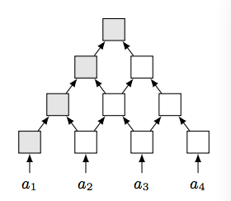
Using a New Class of Language
Linear Conjunctive language [Okhotin 2001]
Precisely describe the D_{c} $⊙$ D_{f} language
A := b B & C c
Closed under all set-theoretic operations
Defined by Trellis Automata
$$b$$
$$B$$
$$C$$
$$c$$
Notes:
Relation regular <-> FSA

Slide 32
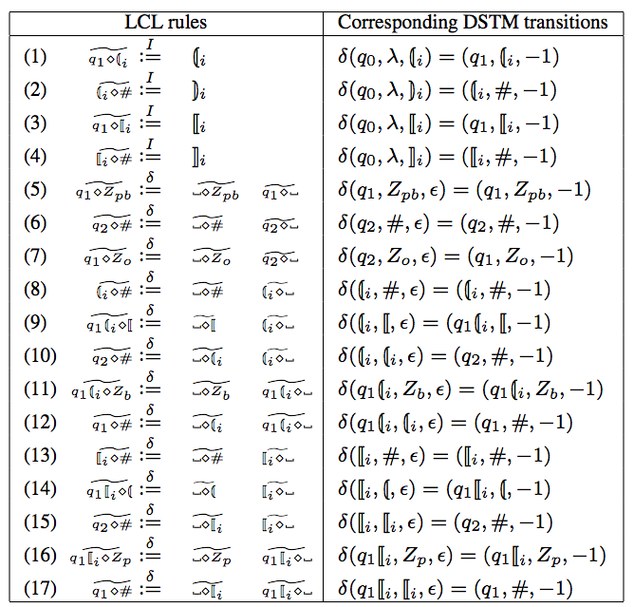
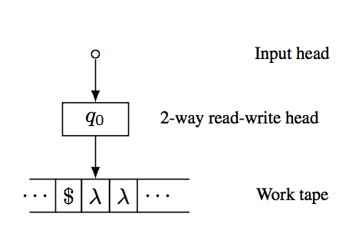
Programming the Trellis Automata

Slide 33
Algorithm for Solving LCL-reachability [Zhang and Su 2017]

Slide 34
Improved Complexity
$Σ_{(u,v)}$ $Δ_{v}$ = $Σ_{u}$ ($Σ_{v}Δ_{v}$ ) = O(n m)
B
B
C
c
A
A
CFL-reachability
LCL-reachability
Notes:
Sigma explain
delta

Slide 35
3. Graph Simplification for InterDyck-Reachability
WPDS, NWA
LCL-reach
Formulation
Graph
Algorithm
CFL-reach
InterDyck-reach
M → M M
| ( M )
| ( )
$$($$
$$)$$
Reachability Framework
a
b
C
Dyck-reach

Slide 36
3. Graph Simplification for InterDyck-Reachability
WPDS, NWA
LCL-reach
Formulation
Graph
Algorithm
CFL-reach
InterDyck-reach
M → M M
| ( M )
| ( )
$$($$
$$)$$
Reachability Framework
a
b
C
Dyck-reach

Slide 37
Interleaved Dyck-Reachability
Undecidable problem [Reps 2000]
Previous efforts:
Better approximation algorithms
Graph simplification [Li et al 2020]:
Simplify the input graphs
Removing useless edges
Inter-Dyck Reachability
Algorithm
Input Graphs

Slide 38
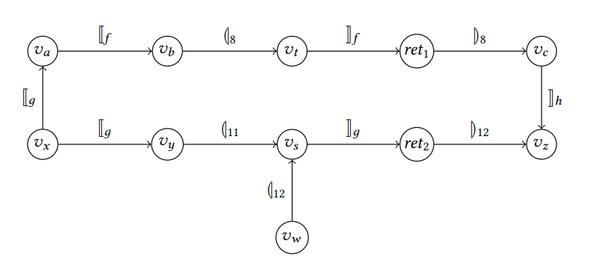
Benefits of Graph Simplification
Better Performance
InterDyck algorithms can work on smaller graphs
Better Precision
False positive pair
No false positive!
Original
Simplified

Slide 39
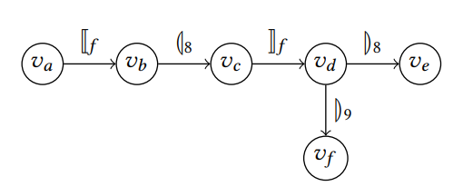
Graph Simplification
What can we remove in the input graph?
Non-contributing Edges
not in any InterDyck-paths.
Contributing Edges
In at least one InterDyck-path.
Graph Simplification
Removing non-contributing edges

Slide 40
Given a graph with n nodes and m edges, removing non-contributing edges for InterDyck-reachability

Slide 41
Compute Non-contributing Edges
Challenges?
InterDyck Reachability problem
Non-contributing InterDyck edges computation
How can we compute a subset of non-contributing edges, fast?

Slide 42
Observation

Slide 43
Observation
For the InterDyck language $L$ = $L_{1 }⊙L_{2}⊙ …⊙L_{k}$
Can we build a new $L_{x}$-graph for each Dyck language $L_{x}$ ?
An edge is InterDyck-contributing
The corresponding edge is Dyck-contributing
In original graph G
In $L_{x}$ graph

Slide 44
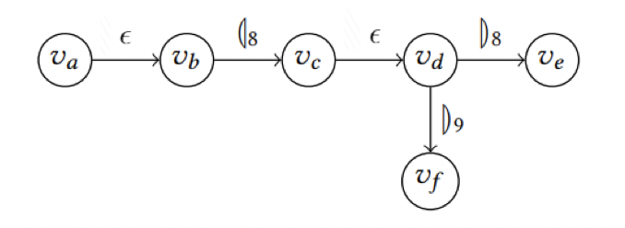
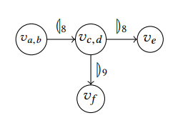
$L_{x}$-Graph Construction
$L_{x}$graph

Slide 45
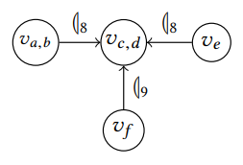
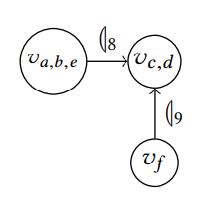
Contributing edges in bidirected L_{x}-graphs
Bidirectedness -> over-approximation!
Original L_{x}-graph
Bidirected L_{x}-graph
Fast-Dyck ☺

Slide 46
Contributing edges in bidirected L_{x}-graphs
Bidirectedness -> over-approximation!
Non Dyck-contributing
Bidirected Dyck-contributing
Dyck-contributing

Slide 47
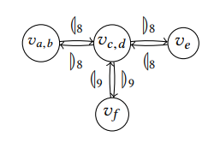
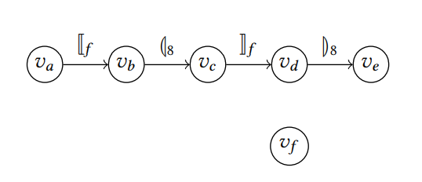
Overview of Graph Simplification
Reachability
Contributing Type
Graph
Original graph
InterDyck Reachability
Non-InterDyck-Contributing
$L_{x}$graph
Dyck Reachability
Non-Dyck-Contributing
Bidirected $L_{x}$graph
Dyck Reachability
Non-Dyck-Contributing
Simplified graph
Time complexity?
O(m log n)-time graph simplification [Li et al. 2020]
☺ FastDyck [Zhang et al. 2013]
O(m)-time graph simplification [Li et al. 2022]
☺ OptmalDyck [Chatterjee et al. 2019]

Slide 48
WPDS, NWA
LCL-reach
Formulation
Graph
Algorithm
CFL-reach
InterDyck-reach
M → M M
| ( M )
| ( )
$$($$
$$)$$
Reachability Framework
a
b
C
Dyck-reach

Slide 49
Outline of Tutorial
CFL-reachability
Origin & background
Algorithm & complexity
Applications
Beyond CFL-reachability
Datalog
WPDS, NWA
Graph reachability
Dyck-reach
LCL-reach
InterDyck-reach
Future Directions
Theoretical developments
Dynamic reachability

Slide 50
Big Picture
WPDS, NWA
LCL-reach
Undecidable!
CFL-reach
InterDyck-reach
Dyck-reach
Notes:
In terms of a typical system for program analysis, which has the pipeline shown on this slide, the algorithm plays the role of the equation solver. It takes as input the equation system that abstracts the actions of the program, and produces as output the solution to the equation system. That solution is then used to identify possible program flaws, or to establish the correctness of the program’s behavior.
<CLICK>
In essence, what we did was to combine two known techniques to create an improved equation solver.

Slide 51
Coping with undecidability
Finding decidable variants
InterDyck:
D_{k1} $⊙$ D_{k2}-Reachability
A restricted variant
Bidirected D₁ $⊙$ D₁-Reachability

Slide 52
Bidirected D₁ $⊙$ D₁-Reachability
A counting perspective
“[” or “(” --- +1
“]” or “)” --- -1
In general setting
“#[” and “#(” are unbounded.
#[
2
1
0
1
2
3
4
5
6
0
1
2
#(

Slide 53
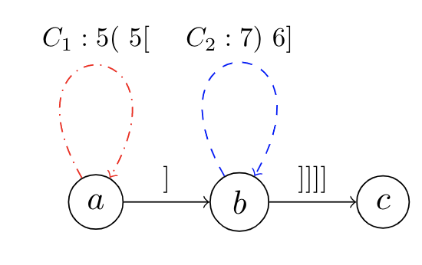
Bidirected D₁ $⊙$ D₁-Reachability
An interesting shallow-path property [Li et.al 2021]
Intuition: path can go “back-and-forth”
Idea: cycle rearrangement
Bound the max depths of “#(” and “#[”
Shallow paths construction
Simple math:
5x = 7y
5x = 1 + 6y + 4

Slide 54
A Taste of Cycle Rearrangement
Assume the bound for a shallow path is 32
A non-shallow path:
A rearranged shallow path to move C₂ to an early location.
Time complexity O(n⁷) [Li et al. 2021]
POPL 2022
New result (by Kjelstrøm and Pavlogiannis): O($n^{3}⋅α(n)$)-Time
Wednesday@15:05 Algorithmic Verification 1 at Salon I

Slide 55
Outline of Tutorial
CFL-reachability
Origin & backgroud
Algorithm & complexity
Applications
Beyond CFL-reachability
Datalog
WPDS, NWA
Graph reachability
LCL-reach
InterDyck-reach
Graph simplification
Future Directions
Theoretical developments
Dynamic reachability

Slide 56
Big Picture
WPDS, NWA
LCL-reach
CFL-reach
InterDyck-reach
Dynamic?
Dyck-reach
Notes:
In terms of a typical system for program analysis, which has the pipeline shown on this slide, the algorithm plays the role of the equation solver. It takes as input the equation system that abstracts the actions of the program, and produces as output the solution to the equation system. That solution is then used to identify possible program flaws, or to establish the correctness of the program’s behavior.
<CLICK>
In essence, what we did was to combine two known techniques to create an improved equation solver.

Slide 57
Dynamic graph reachability
Graphs are under a sequence of edge insertions/deletions
Algorithmic foundation for interactive program analysis
A a;
a.f = x; //taint value
y = a.f;
z = a.g;
[_{f}
]_{f}
x
a
y
]_{f}
[_{f}
]_{g}
Reachability Framework
[_{g}
z
S := [_{f} S ]_{f}
S := [_{g} S ]_{g}
S := S S
S := $ε$
Dyck language

Slide 58
Dynamic graph reachability
Graphs are under a sequence of edge insertions/deletions
Algorithmic foundation for interactive program analysis
A a;
a.f = x; //taint value
y = a.f;
z = a.g;
[_{f}
]_{f}
x
a
y
]_{f}
[_{f}
Reachability Framework
z
S := [_{f} S ]_{f}
S := [_{g} S ]_{g}
S := S S
S := $ε$
Dyck language

Slide 59
Bidirected Dynamic Dyck-reachability
Pre-processing: handle the input graph
Update: handle each edge insertion/deletion
Query: if v and u are Dyck-reachable
 | Pre-processing | Update | Query
Naïve 1 | O(1) | O(1) | O(m)
Naïve 2 | O(m) | O(m) | O(1)
POPL 2022
New results (by Li et. al):
O(m)-time pre-processing, O($n⋅α(n)$)-time update, O(1)-time query Wednesday@15:05 Algorithmic Verification 1 at Salon I

Slide 60
Summary 1
Past and present
Theoretical development
Practical applications
“Taming” undecidability
New algorithms
Graph simplification
Future
Practical, decidable variants
Dynamic variants
Applications, applications

Slide 61
Summary 2
The joy of research
FastDyck [Zhang et al. 2013]
OptDyck [Chatterjee et al. 2019]
Simplification [Li et al. 2020]
Simplification [Li et al. 2022]
InterDyck-O(n⁷) [Li et al. 2021]
InterDyck-O(n³) [Kjelstrøm and Pavlogiannis 2022]

