Slide 1
CS 8803 Topics in Program Analysis
Qirun Zhang

Slide 2
Agenda
Course Objectives
Course Logistics
Course Overview

Slide 3
Introduction
Assistant Professor in CS
Research interests: Programming languages
  Two past projects
    Alias analysis (cflaa pass)
    Compiler testing (LLVM/GCC)
Contact
  Office: KACB 2324
  Email: qrzhang@gatech.edu

Slide 4
Objectives

Slide 5
My expectation
A personal perspective
“PL”-thinking

Slide 6
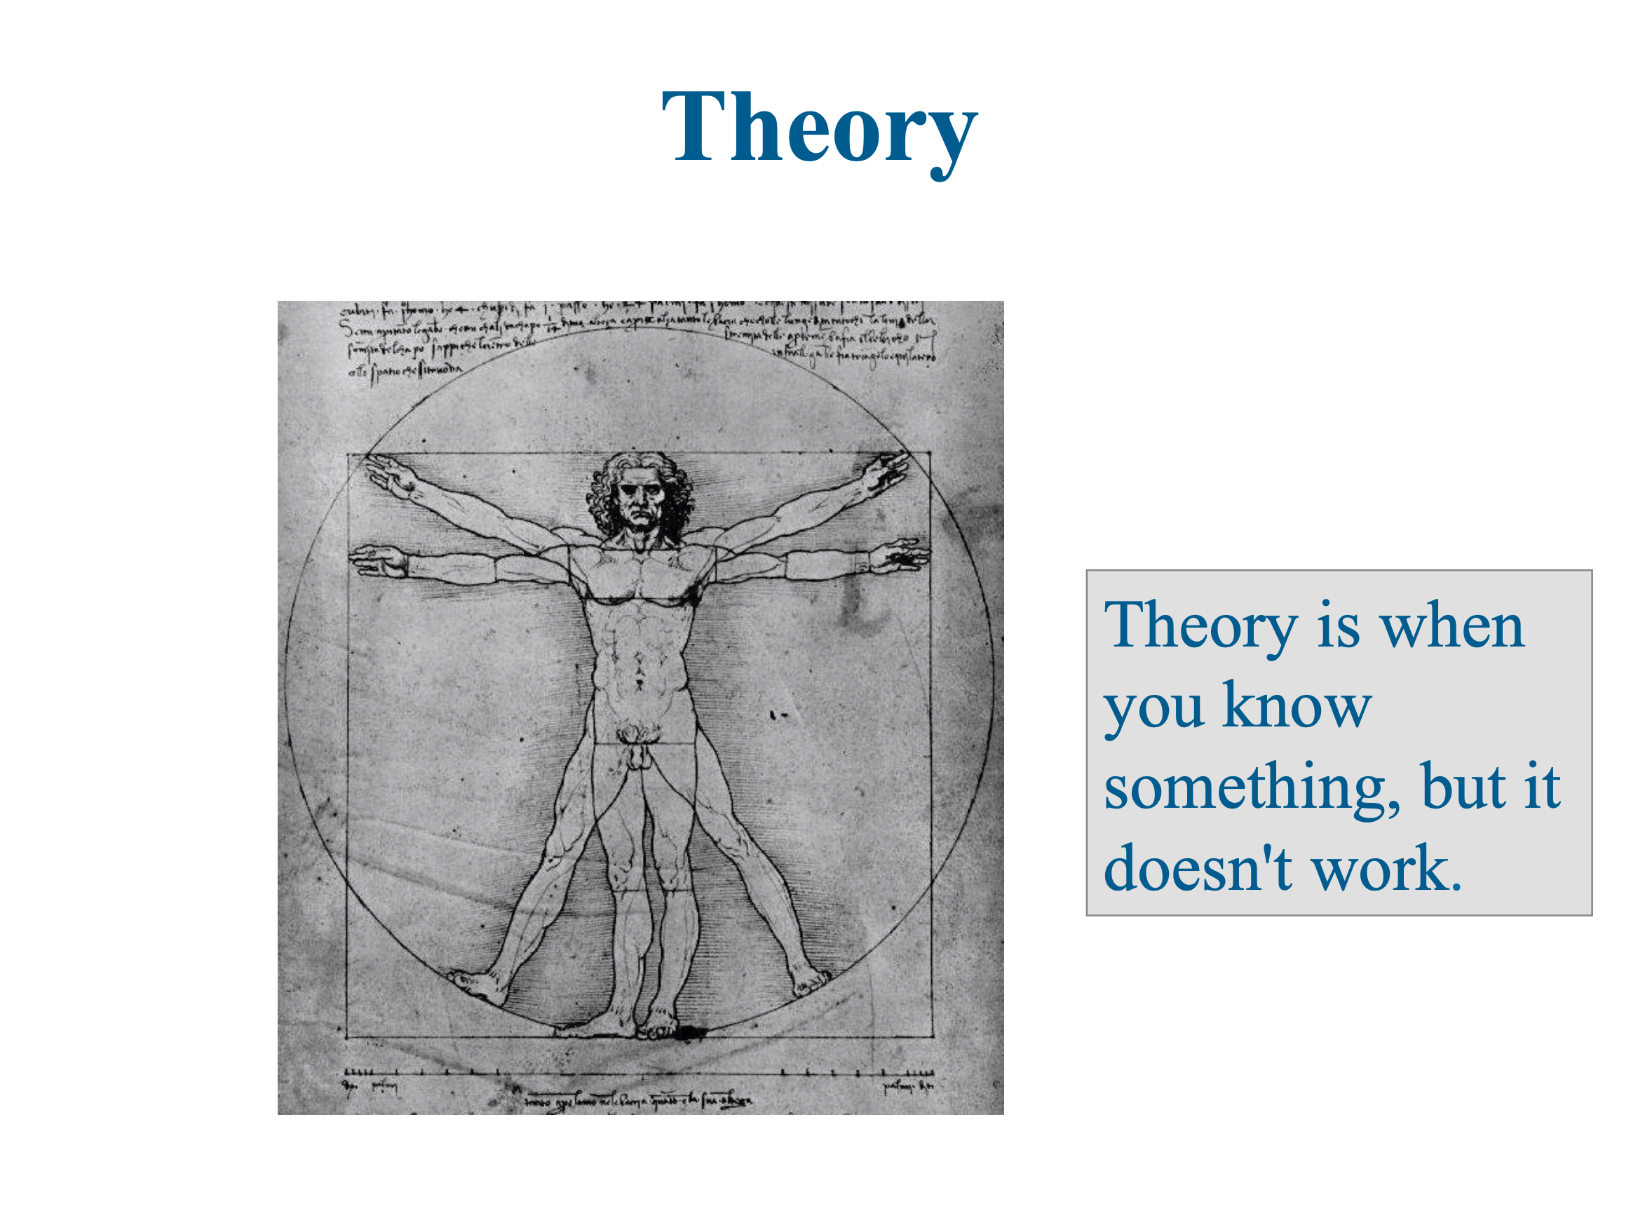
From Giuseppe F. (Pino) Italiano

Slide 7
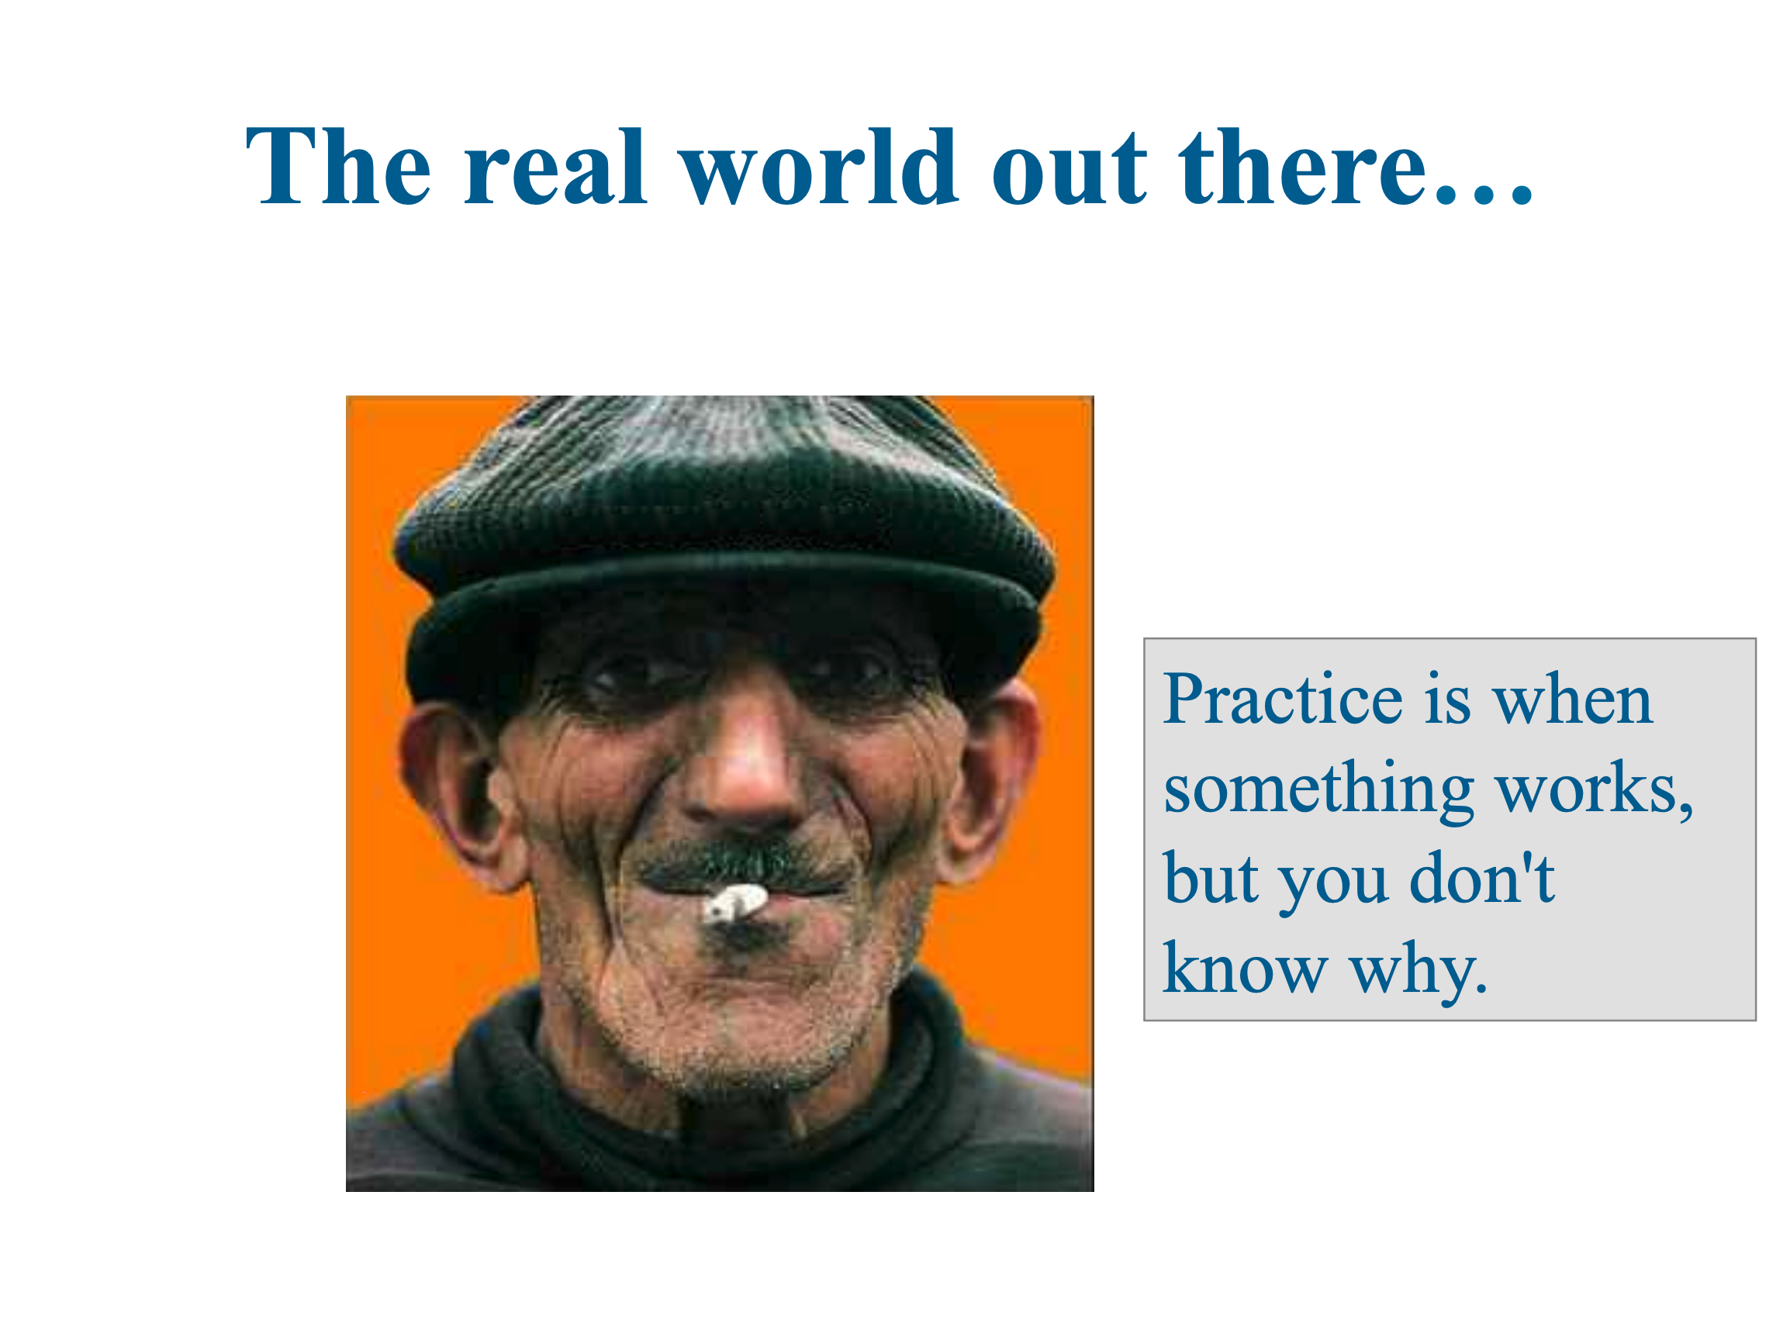

Slide 8
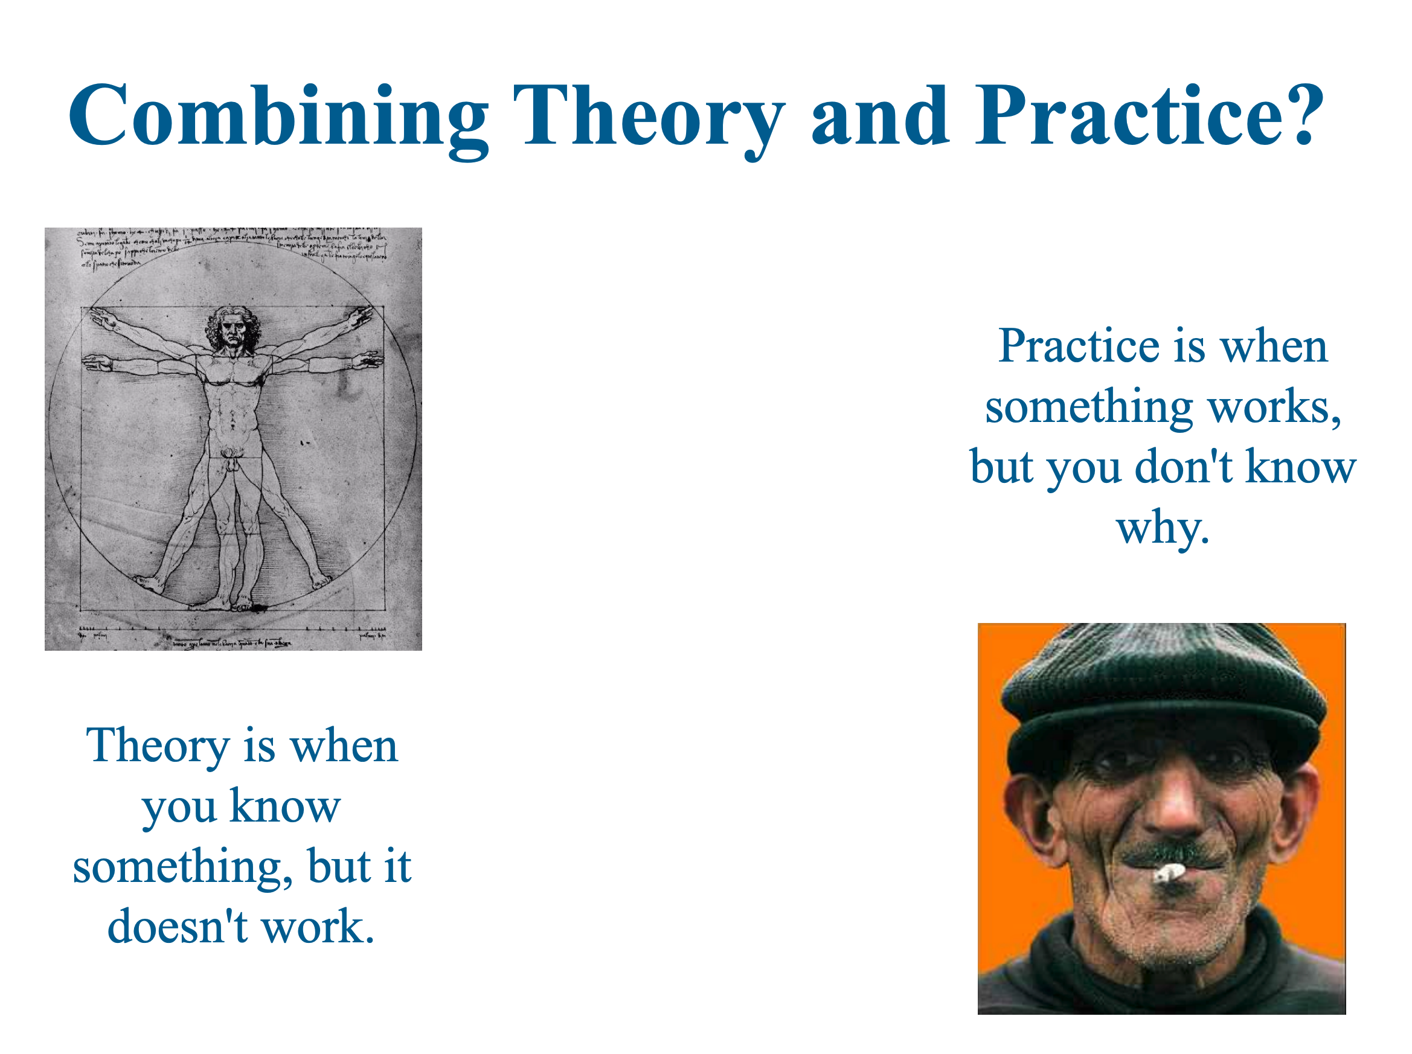

Slide 9
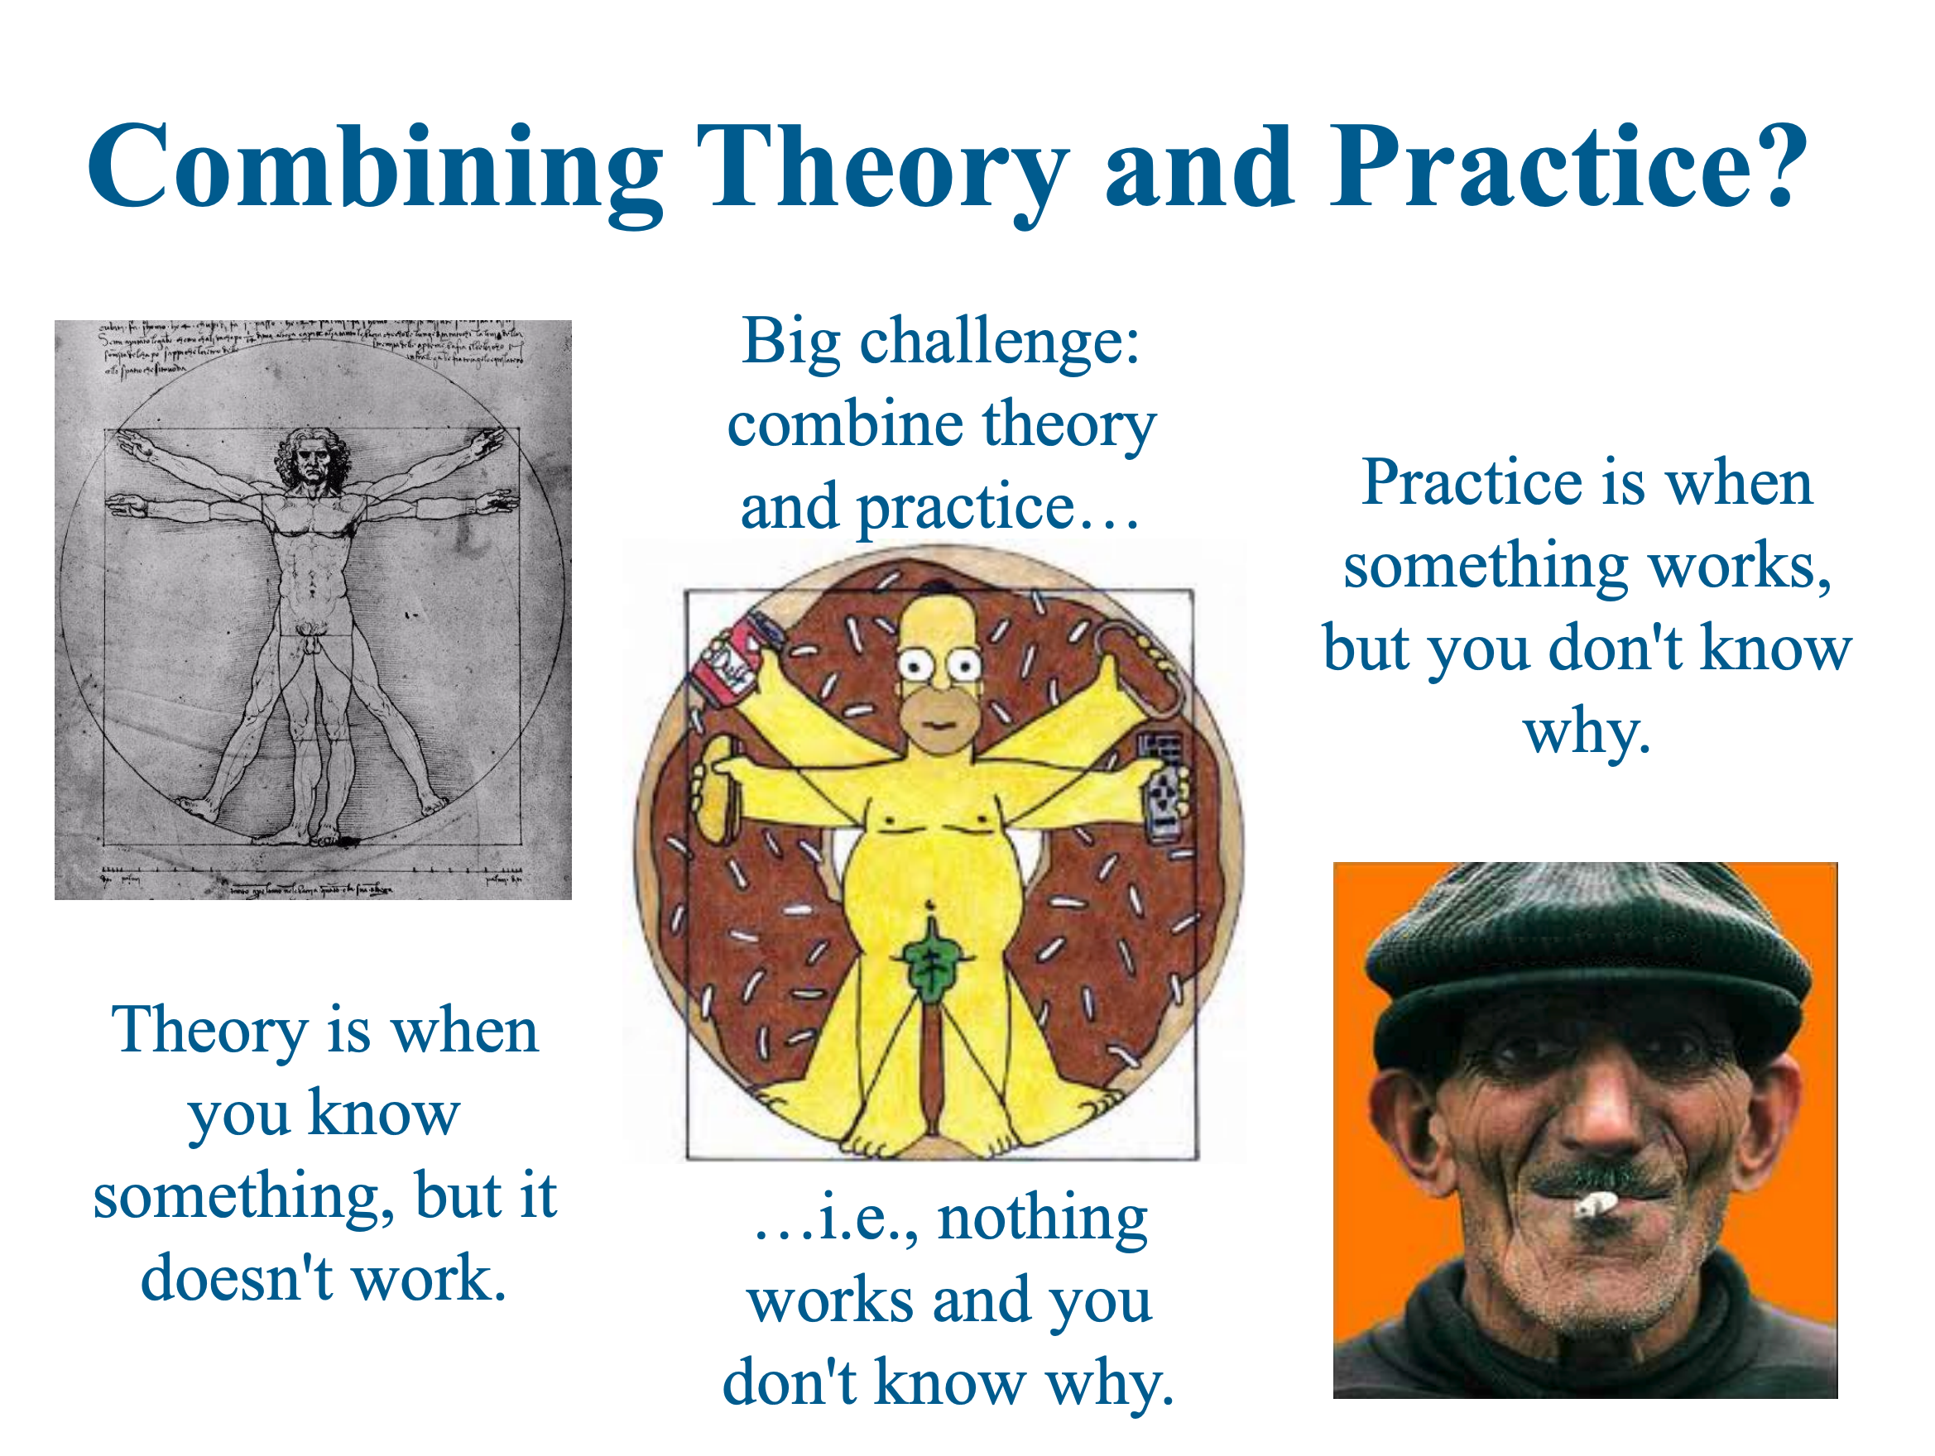

Slide 10
Why this course?
PL is one of the core topics in CS
Curiosity
Being cool
Solving read-world problems
Enjoy!
Notes:
https://dl.acm.org/sig.cfm?id=SP946

Slide 11
Course Objectives
Learn the topics
Find the overlap with your research
Practice writing
Practice presentation
Group discussion

Slide 12
Logistics

Slide 13
Course logistics
Website: https://www.cc.gatech.edu/~qrzhang/course/cs8803/index.html
Course announcement
  Website
  Canvas (via email)

Slide 14
Course structure
Paper review
Paper presentation
Project

Slide 15
Paper review
Study note vs conference review
Have an illustrative example
List your questions
25 papers (tentative)
  18 reviews in total
    No late submission for theses reviews.
    #PaperReview + #PaperPresentation = 18.
    About 16 paper reviews for everyone.
  Send the paper review to qrzhang@gatech.edu
    With the title [8803 reading] Yourname:Papername
    by 10:00 pm EST the night before the class discussing that paper.
      Example: if we are going to discuss paper X on 9/10, you need to send the review by 10:00 pm on 9/9.
If you are presenting, you don’t need to submit the review.

Slide 16
Paper presentation
50-min presentation
  Be thorough
  Make sure to introduce the background
25-min discussion

Slide 17
Course Project
Ideally, work as a group of 2 people.
You can also work solely.
Suggestion
  Form your group sooner than later.
  Find your project topic sooner than later.
Milestones
  Project proposal
    A conference-intro-style report
  Project report
    Similar to a conference paper
  Project presentation

Slide 18
Course Topics

Slide 19
Todo List
Reading for the first week (see Optional Reading on the course page)
Check the course webpage and pick 5 papers (to present).
  Send the paper names to qrzhang@gatech.edu
  Deadline: 8/23 10pm ET
Send the first paper review
  Send the review to qrzhang@gatech.edu with the title “[8803 reading] Yourname:Papername”
  Deadline: 8/26 10pm ET
Think about project topics and form a group
  Deadline: TBD, in September.

Slide 20
Static Analysis

Slide 21
Deciding Non-trivial program properties (without running the program)
Can variable x equal value v at label L?
Must variable x equal value v at label L?
What is the sign of x at L?
Can there be any overflows in the computation performed at L?
…

Slide 22
Consider the problem
Given program P, is it the case that on all runs of P, variable x has the same value at the end of execution?

Slide 23
Soundness

